Slide 1
VEHICLE INSURANCE PREDICTION
MINI PROJECT 2
SEPTEMBER, 2021
BY
ANTHONY NNAMANI

Slide 2
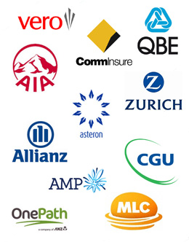
Business question
Can we know which of the customers will be interested in our car insurance based on our historical data using machine learning?

Slide 3
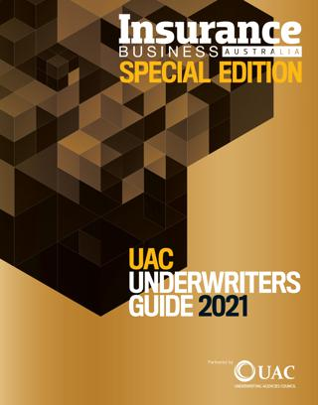
Importance of the question
Australian insurance market has been estimated to worth up $76.3 billion in 2020 and it is project to grow to $98 billion in 2025.
Market share : $7b
Number of businesses : 866
Industry Employment : 48,300 people
Motor insurance make up to 24.4% of the market share

Slide 4
Data overview
Publicly Available Data from Kaggle website.
Contains about 381109 observations with 11 features
Data divided into two (Train and Test split)

Slide 5
Pipeline
Pipeline
Define
Data acquisition
Business questions
Strategy
Data Cleaning
Exploring data
Cleaning
Visualization
Plotting interested variables from the data to get insight
Preprocessing
Conducting hypothesis testing on the dataset
Modelling
RandomForest
Logistic Regression
Naïve Bayes

Slide 6
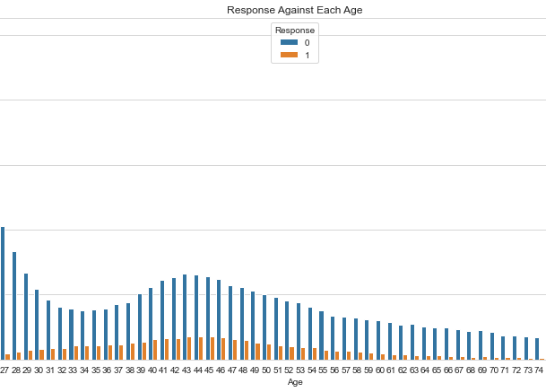
Age distribution and car insurance response
Customers that buy car insurance with them are mostly between the age of 30 to 60 years of age

Slide 7
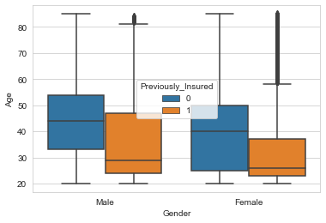
Analyzing gender and car insurance
In general, the number of customer that not previously insured with the company is the higher than the customers that had car insurance with the company.
It can also be seen that more male than customers already car insurance from the company.

Slide 8
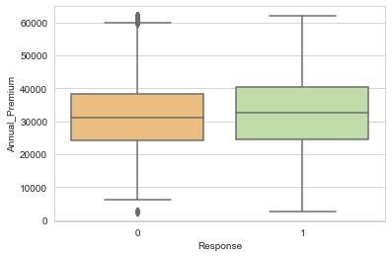
Analyzing annual premium and Response
Customers that pay higher in their premium are more likely to buy the vehicle insurance even though the difference is not much. This could be because those customers has more money and so can afford it.

Slide 9
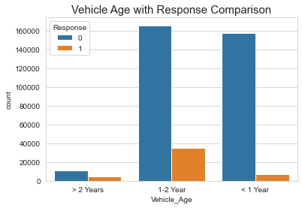
Relationship between vehicle age and car insurance
Customer with vehicle between 1to 2 years are more likely to buy car insurance than customers that own car that is more than two years and customers that own cars that are less than one year old

Slide 10
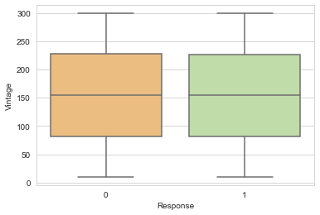
Impact of vintage on the Response
Vintage here represent how long in the number of days the customer has been with the company.
From the plot, there is no noticeable difference between the two group. How long the customer has been with the company does not really matter

Slide 11
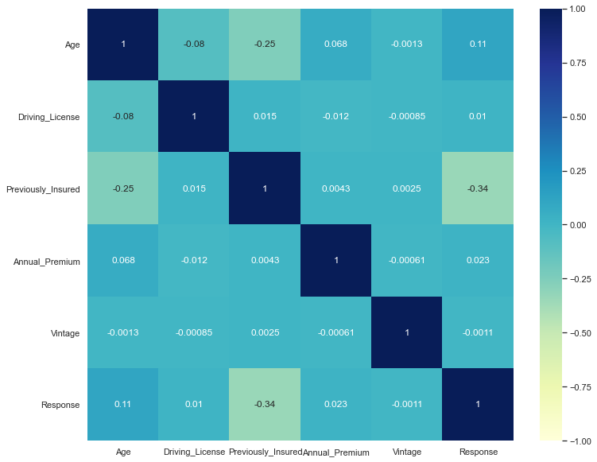
CORRELATION HEATMAP

Slide 12
Pre-processing and modelling
Dataset was randomly divided into train and test
Did oversampling using SMOTETomek
Scaled data using standard scaler
Trained three different models as follows
Logistic Regression
RandomFroest
Naïve Bayes

Slide 13
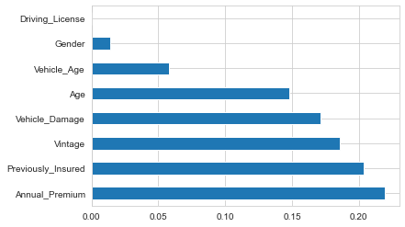
Feature importance

Slide 14
RESULT
FROM CONFUSION METRIX
The aim of this study is for the company to identify each group of their customers and target them with appropriate marketing strategy in order for the customers to buy vehicle insurance from them.
Therefore, precision and recall are equally important for this study, hence reason to choose RandomForest as the better model.
RESULT
 | ACCURACY | PRECISION | RECALL | F1-SCORE
Logistic Regression | 0.78 | 0.73 | 0.90 | 0.80
RandomForest | 0.85 | 0.82 | 0.90 | 0.85
Naïve Bayes | 0.78 | 0.71 | 0.96 | 0.82
RandomForest is the better model

Slide 15
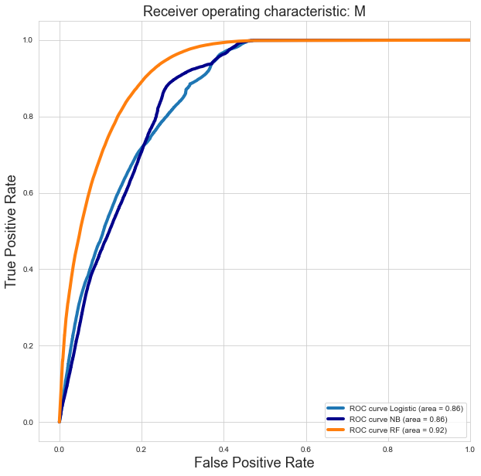

Slide 16
SUMMARY
Insurance business is a very big business with about $7b market share
Motor insurance make up to 24.4% of the insurance market
As the market is competitive, it is important for insurance companies to apply AI to better understand their customer and serve them better
Using machine learning to predict the possibility of a customer buying car insurance from a company or not will help the company to devise appropriate marketing strategy for a each group of customers.

Slide 17
THANK YOU

